Slide 1

STACK
System for Teaching and Assessment using a Computer algebra Kernel

Slide 2

Introduction
Associated Google Docs File
What is STACK?
Why STACK?

Slide 3
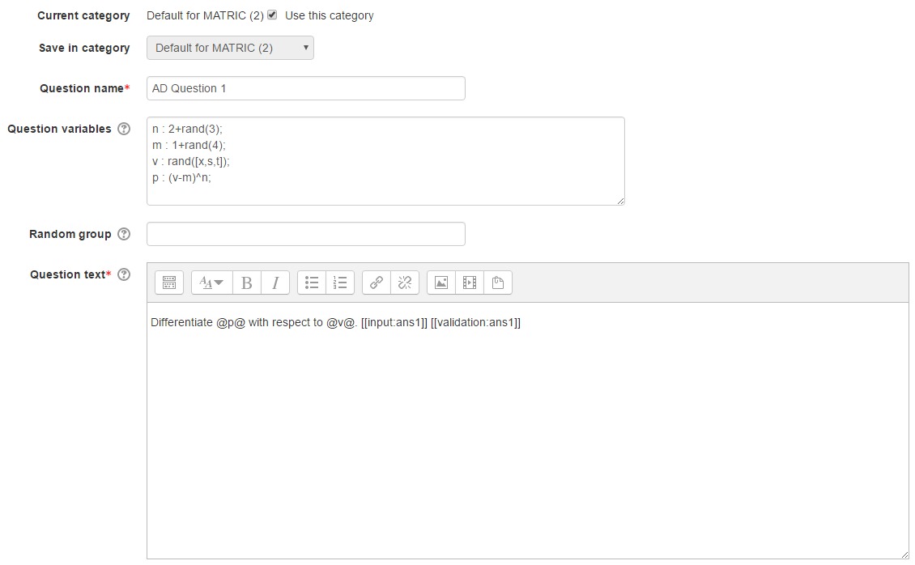
STACK Questions
Question Name
Question Variables
Question Text
Input (ans1)

Slide 4
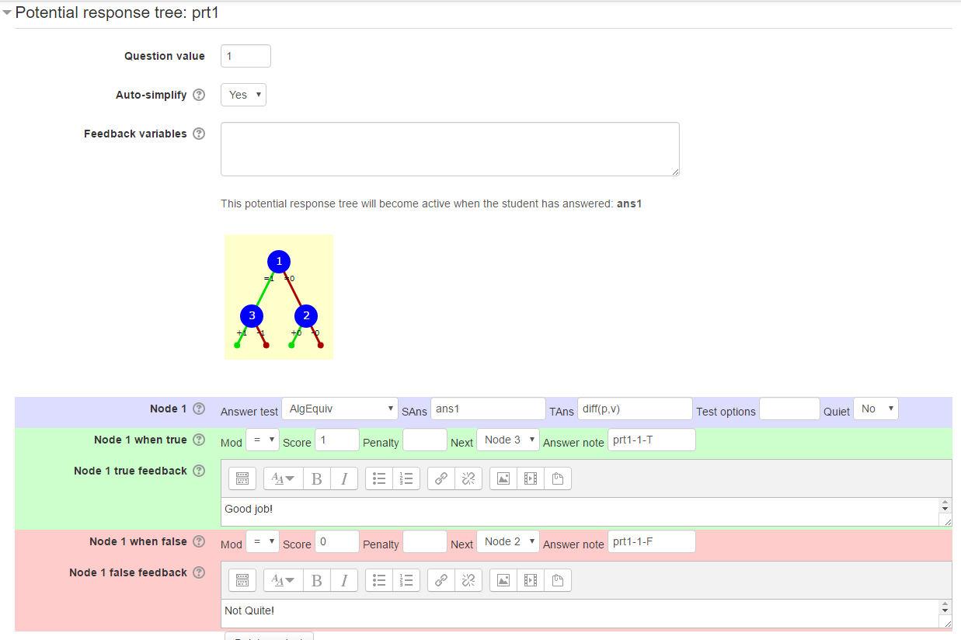
Potential Response Tree
Nodes
True/False Feedback
Testing

